Slide 1

ECE 2031 Project Proposal
Team 101 – Caleb Song, Harsha Tambareni, Maya Rajan, Michael Probst, Sarah Copenhaver

Slide 2

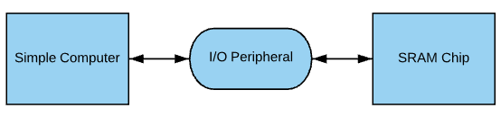
Design Problem
Create an IO peripheral from SCOMP that will interact with the SRAM chip on the DE2 board.
Read/write capabilities
Balance ease of use and speed to make the most effective peripheral

Slide 3


Design Problem: Inferences
The memory will likely be used for a storing data from a source like sonar
Interface must excel in continuous reads and writes
Image Source: http://powersof2.gatech.edu/resources/DE2Bot/DE2BotUsersManual_v5.pdf
Notes:
If something needs to be stored in one specific location or read from there, this can more easily be done in the onboard memory

Slide 4
Design Solution Overview
Our solution may contain an option to specify in input data for how many reads or writes will occur
Streamlined VHDL implementation of SRAM will make timing improvements via state machines and signal concatenations
Image Source: http://powersof2.gatech.edu/resources/DE2Bot/DE2BotUsersManual_v5.pdf
Notes:
This takes advantage of the linked-together reads or writes

Slide 5
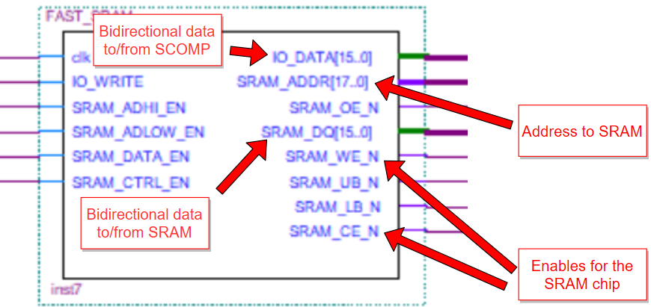
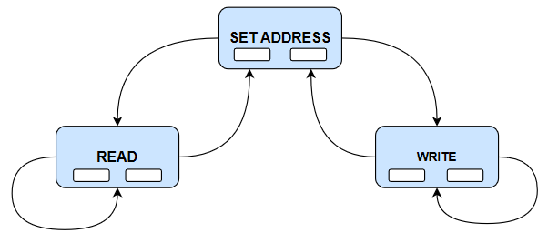
Technical Approach: State Machine
Inputs:
io_data from decoder
io_write from scomp
enables from decoder
Moore outputs:
sram_dq to sram
sram_address to sram
OE, and WE to sram
io_data to scomp

Slide 6
Pros and Cons of State Machine
Pros:
Provides control over timing to meet requirements
Utilizes simpler design than combinational logic
Enables reuse of signals to decrease delays
Allows user to execute sequential reads or writes
Cons:
Takes time to transition between states
Requires many additional enable and internal signals

Slide 7
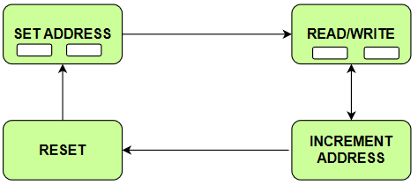
Sequential Read/Write
Prepares the next write address after the current read/write
Reduces the number of instructions required to read/write
Requires fewer steps in the assembly code

Slide 8
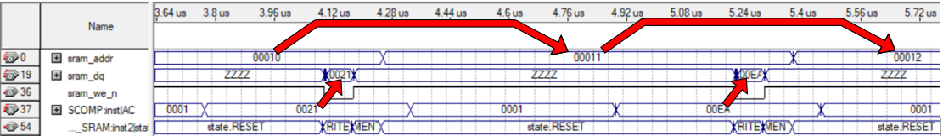
Sequential Write Example
The data line is driven by the accumulator from the Simple Computer
Write Enable is asserted (active low)
Address is automatically incremented during an extra state
SRAM is prepared to receive the next instruction

Slide 9
Technical Aspects: Signal Concatenation
Reducing the amount of LOADI instructions by combining values in the IO_DATA input
IO_DATA: [16 bits]
Decoder Address #1: 0x10
Empty Space: [15..3]
CTRL value: [2..0]
Decoder Address #2: 0x13
Empty Space: [15..5]
High Address: [4..3]
CTRL value: [2..0]
High Address: [15..14]
Sequential Increment Value: [13..3]
Decoder Address #3: 0x14
CTRL value: [2..0]
High Address: [15..14]
Decoder Address #4: 0x15
Sequential Increment Value: [13..0]

Slide 10
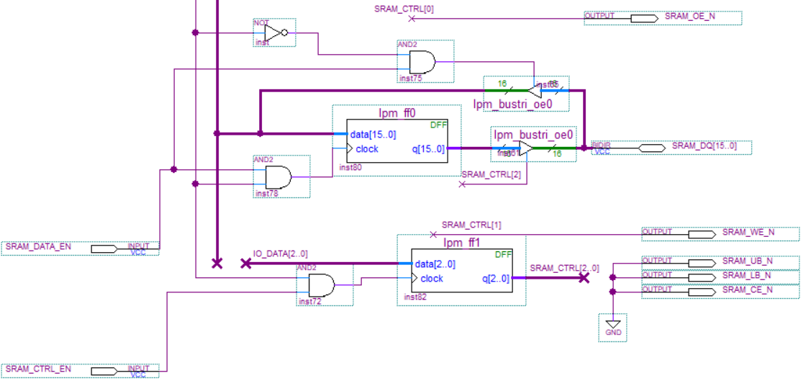
Technical Aspects: Reduced Cycling
The improved SRAM we are creating has reduced logical dependence over time
Utilization of organized states reduces the need for redundant information to be passed through logic gates (each of which can take up to a half of a clock cycle)
Notes:
the simpler the logic, the easier it is to understand. in the picture it is an example of logic we don’t need to do thanks to the state machine (not every time, at least).

Slide 11
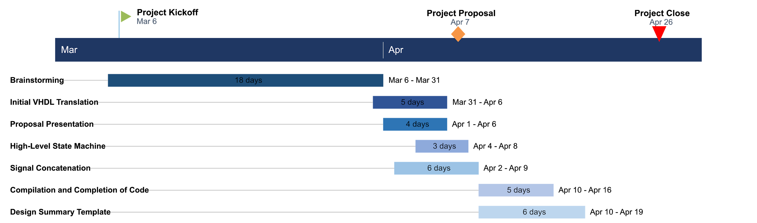
Timeline

Slide 12
Division of Labor
Roles are assigned generally, with specific goals for each role set at every meeting
Team members work on one of the following:
Main VHDL code efficiency
Exploration of alternative efficiency improvement methods
Project assignments
Code organization/readability
VHDL State Machine (Lead)
VHDL State Machine (Check)
Signal Concatenation Research and Development
Proposal Presentation (Lead)
Proposal Presentation (Check)
Sample Division of Labor for Main Roles
Notes:
The roles mentioned are your “main roles,” but you may have other goals

Slide 13
Contingency Plan and Final Thoughts
In the case our idea does not work, we will implement our existing VHDL
Simulation proof of the sequential write capability working
Basic write and sequential write capability that is ~2x faster than SLOW_SRAM.
In the case read cannot be implemented, we will have to use the logic diagram to VHDL method for SRAM reads
Logic implementation with D-FlipFlop and decoder assertion as clock.
X
X

